Slide 1
Real World Nutanix
By James Kilby
@Jameskilbynet

Slide 2

About Me
Senior Cloud Engineer for a Zen Internet
Primary focus on VMware + supporting stack
Working with VMware technology since 2008
Awarded VMware vExpert 2014-2017
Veeam Vanguard 2017 - Veeam UK usergroup founder
Nutanix Platform Professional
Nutanix Technology Champion
Notes:
Presented a few times on Puppet Veeam + DR General storage
Questions welcome at any point
or come and chat to me after

Slide 3
Overview
So why Nutanix ?
What is it ?
The good the bad and the ugly…..

Slide 4
Road to Nutanix
vCloud Director Infrastructure refresh project
Traditional 3 Tier Dell, HP + Cisco…
Storage HP, Dell, EMC, Nimble, Pure
HCI - VSAN, Nutanix, Atlantis, Simplivity
Notes:
Looked at lots more We run SAN both FC and iSCSI by 4 different manufactures
VSAN to expensive - VSPP ( Called out by a number of providers) - This has now been changed

Slide 5
7 Clusters Built
2X Management (NX-1065-G4)
2X Public Cloud (NX-8035-G4)
2X ISP Systems (NX-8035-G4 & G5)
1X Test Cluster (NX-3000-G5)
Notes:
In prod today. Concentrating on scaling out. 4 Nodes arrived this week
very different workloads across the clusters
Slowed down by:
Introduction of NSX
Datacentre consolidation
New WAN!!

Slide 6
So What is Nutanix ??
Hyper-Converged Infrastructure
vSphere, Hyper-V, Xen & KVM (Acropolis)
All built around the CVM( Controller Virtual Machine)
SuperMicro, Dell, Lenovo or Cisco UCS hardware
Notes:
No Backplane
All internode transfer through standard 10gb
node=host
block=chassis
Specs are our 8000 series

Slide 7
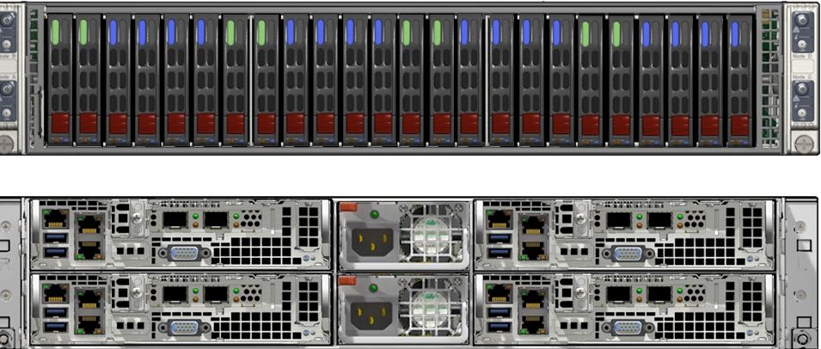
Notes:
3000 Series
4 node

Slide 8
So what is the CVM?
CentOS based VM - core to Nutanix
All I/O - compress, dedupe & erasure coding
Only Nutanix component that uses any RAID (mdraid)
Boot from ISO and SATA DOM
Notes:
No ASIC’s - All X86
Tiny part of the SSD’s are used for the CVM os hence the raid ( in dual sad systems)
All disks/SSD are serving all I/O- always.
No hot spares etc

Slide 9
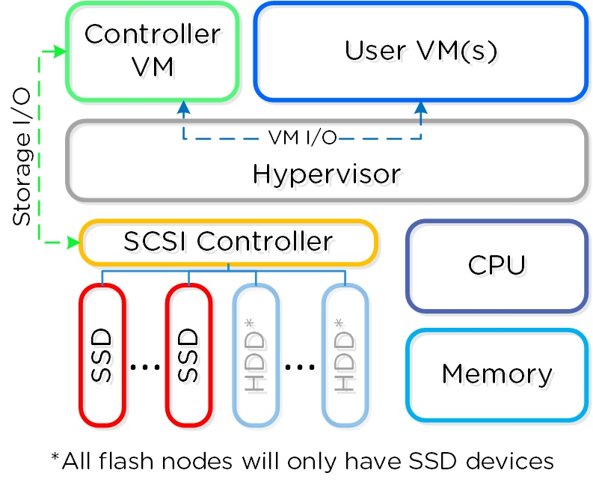
CVM Logical Layout
One CVM Per Node
First VM to Boot
Notes:
Typically 2 SSD. 4 DISK.
MGMT 1 ssd 2 disk

Slide 10
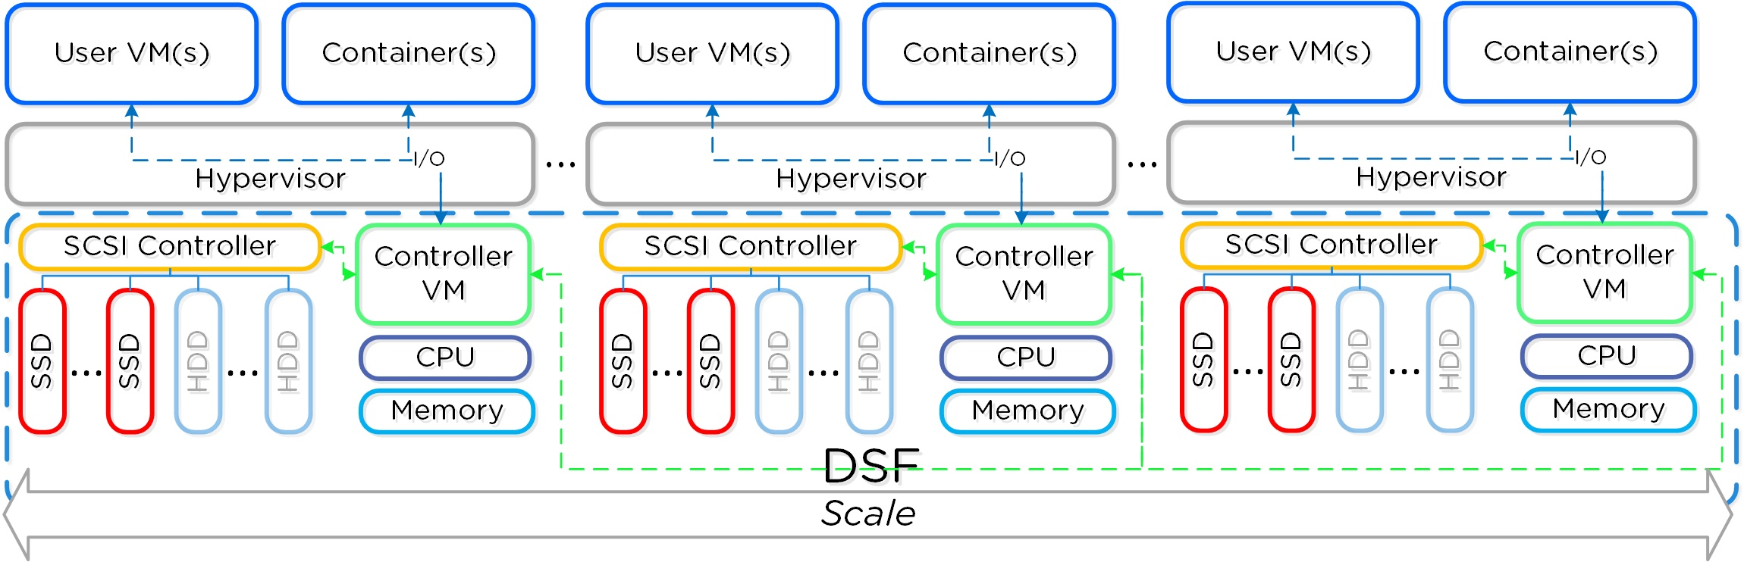
Distributed Storage Fabric
Notes:
DSF is the fabric that containers ( different properties ) are added onto
these are then presented as NFS back to VMware
Scale out almost limitless

Slide 11
What else does the CVM do ?
Prism Element (control plane)
Backup - Nutanix cluster or AWS/Azure
Replication - Nutanix cluster (async/metro cluster)
Cluster performance trending, alerting & patching
Notes:
AWS - Single node cluster M1.XLarge
vCenter, VUM, vROPS, vSphere Replication, vSphere Data Protection, vSphere Web Client, Platform Services Controller (PSC) and the supporting database platform (e.g.: SQL/Oracle/Postgress).

Slide 12
But isn't it hungry ?
Default 8vCPU and 16GB of RAM
Notes:
We run our CVM’s with 24-32GB OF RAM. Typically not short of ram in our clusters get extra read cache. 5% of ram.
24GB recommended for dedupe
2x14 CPU with HT. 14-28%
CVM also has reservations

Slide 13
CVM Data Services
Replication factor + checksumming (every read & write)
Autopath - Preference to local CVM where possible
Writes - always local and remote before being acknowledged
IO - Tiering within CVM
Notes:
In failed condition I/O served from remote CVM over 10Gb
Not Every I/O is served locally. but most are. (read). verified in our environment
RAM LOCAL SSD REMOTE SSD. Local or remote disk. Local CVM monitor. ( disk queue)

Slide 14
IO Tiering
Notes:
SSD like performance random writes into SSD before draining
Sequential go straight to disk
Unified cache made up of single touch and multi touch pool

Slide 15
SSD
HDD
Notes:
Complex operations going on under the hood to optimise performance and scale
Simple to use

Slide 16
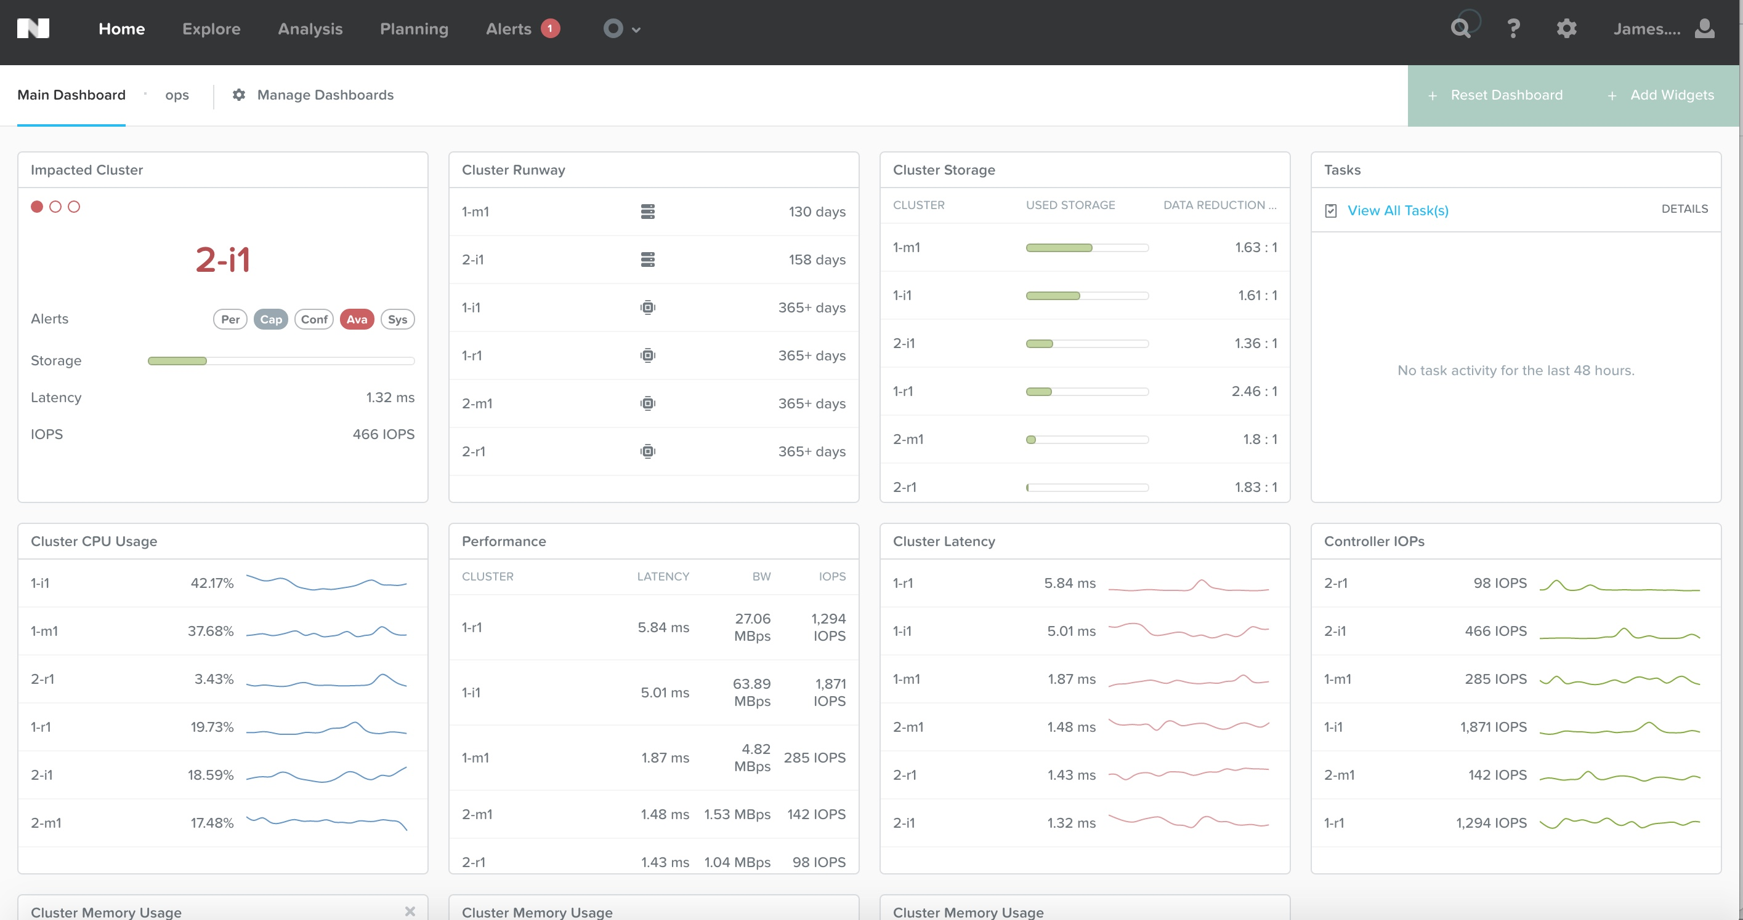
Prism Central
Notes:
Shiny html5 snappy. Able to see hardware system and VM performance capacity and issues Instantly
running 100’s of checks to ensure cluster is healthy and performing as expected

Slide 17
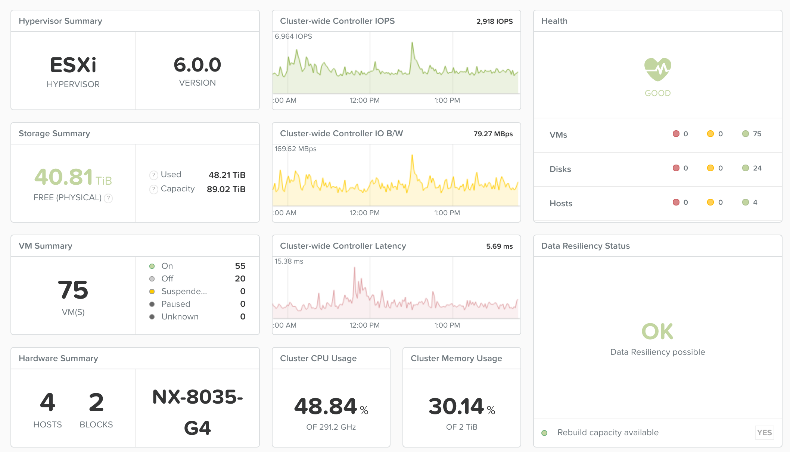
Prism Element

Slide 18
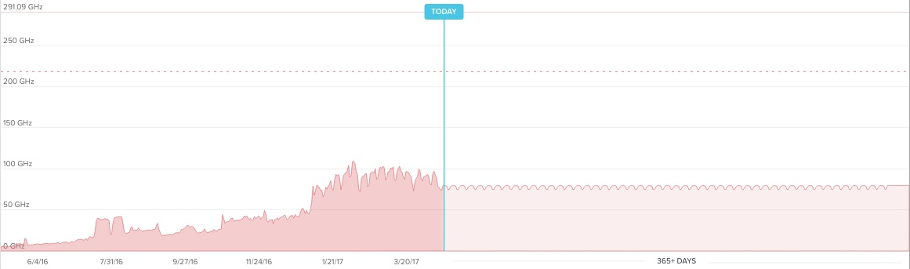
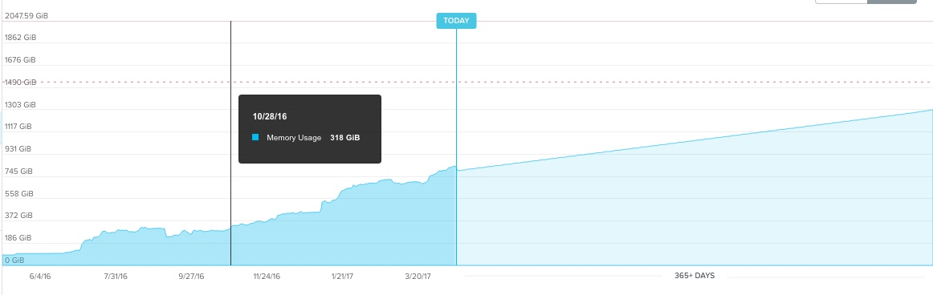
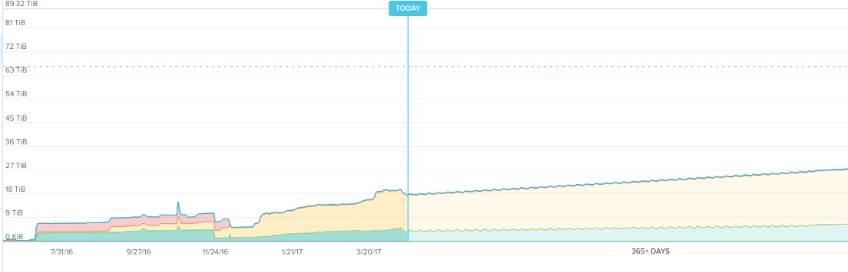
Capacity Management
CPU
RAM
DISK
Notes:
Constantly calculating the days required before you runout
4 host cluster. dotted line at 75%
As a customer were looking for them to trend at the same rate

Slide 19
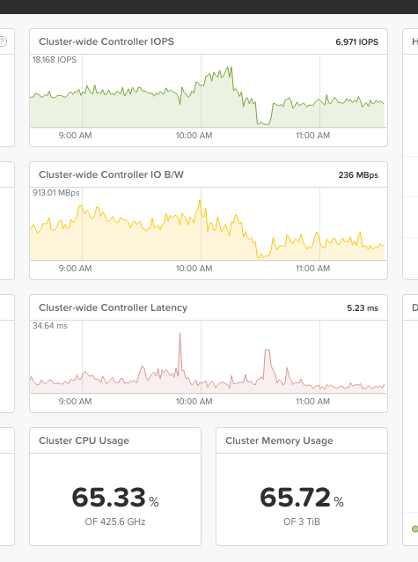
We are achieving this on our cloud products

Slide 20
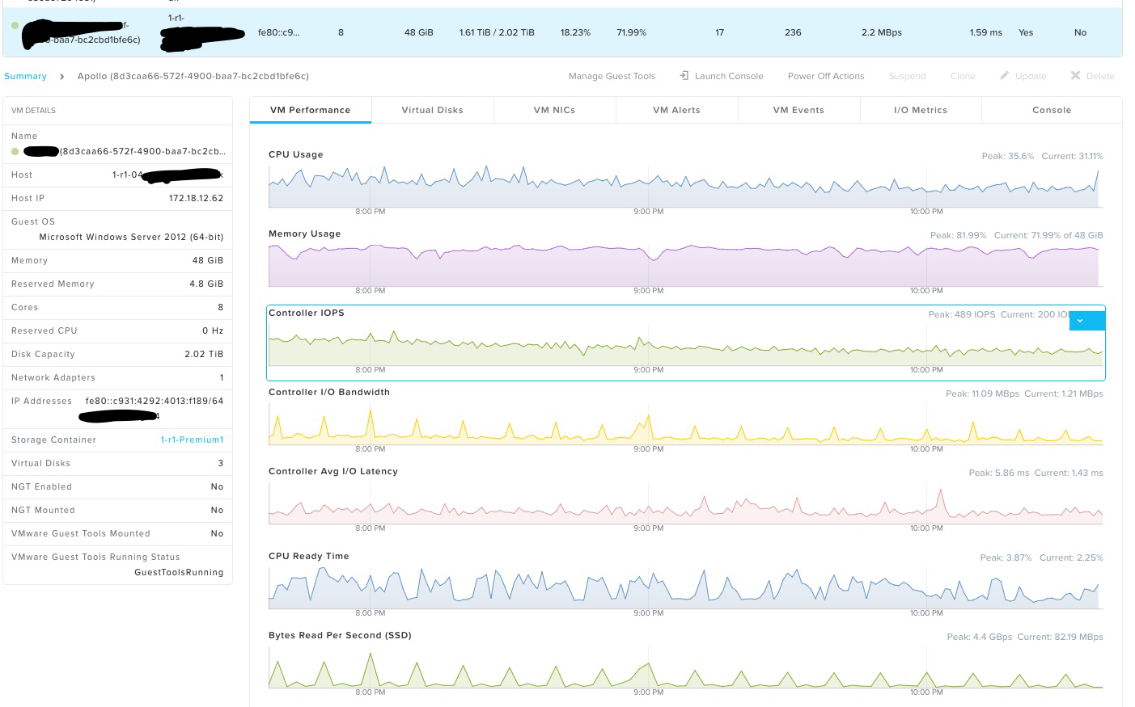
Drill Down Metrics
›
Notes:
Powerful diagnostics. = OPS team use heavily
IAAS customer. SQL Server 48gb RAM 2TB Previously on Dedicated SSD Tier
last 3hrs at glance can add to custom dash and go back in time
IO steady state 1500-2000 with peaks around 8-1000

Slide 21
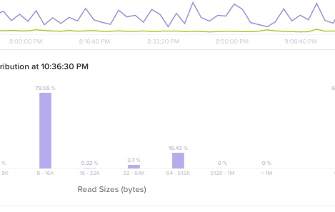

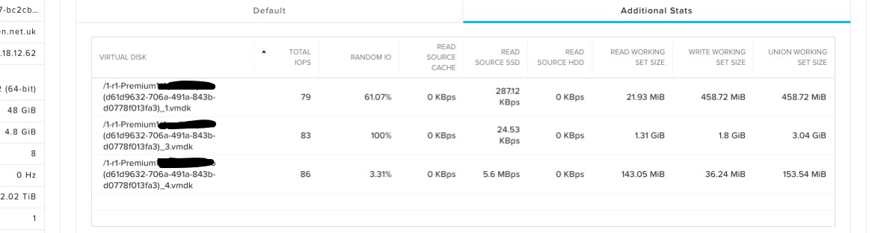
Drill Down Contd
Notes:
IAAS Customer _ previosuly all flash tier of trad san
Read by SSD 99.93%
HDD 0.07

Slide 22
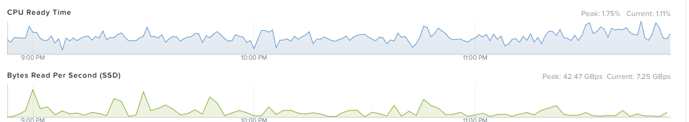
Real World Performance
Log Insight Instance
Peak 42GBps
Notes:
Log insight Mgmt Cluster ( much less flash)
Peak 42GBps
3x Node. 500GB SSD + 4TB Disk per node

Slide 23
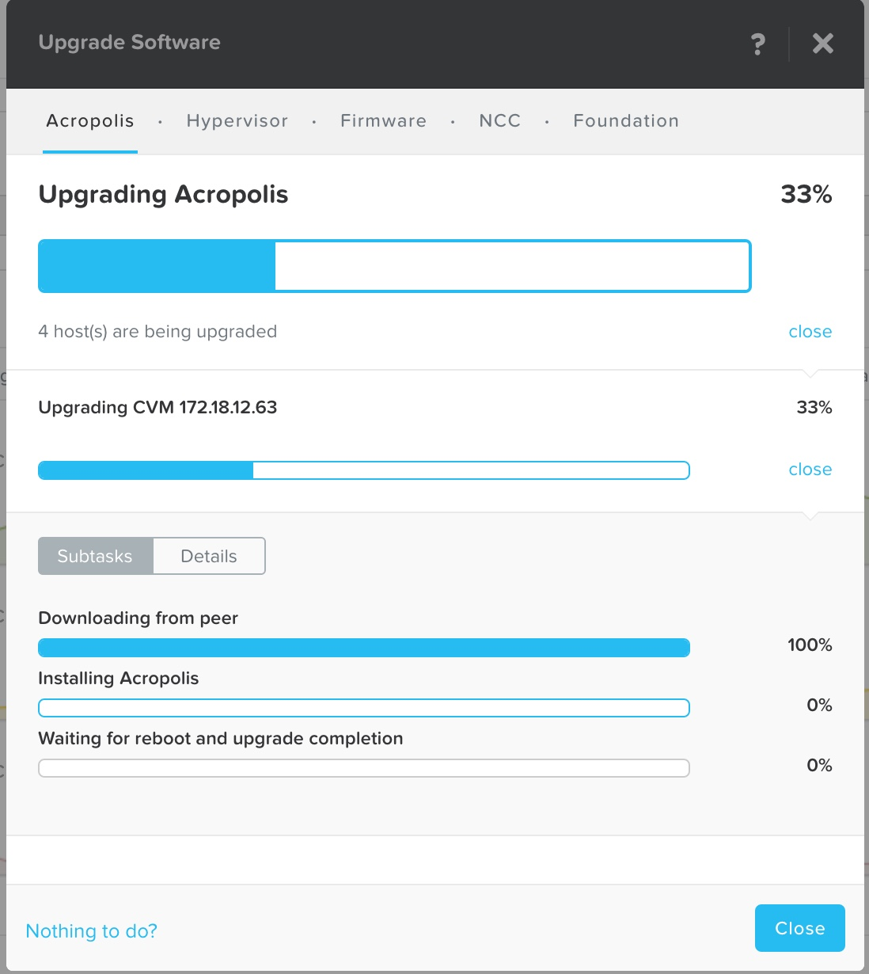
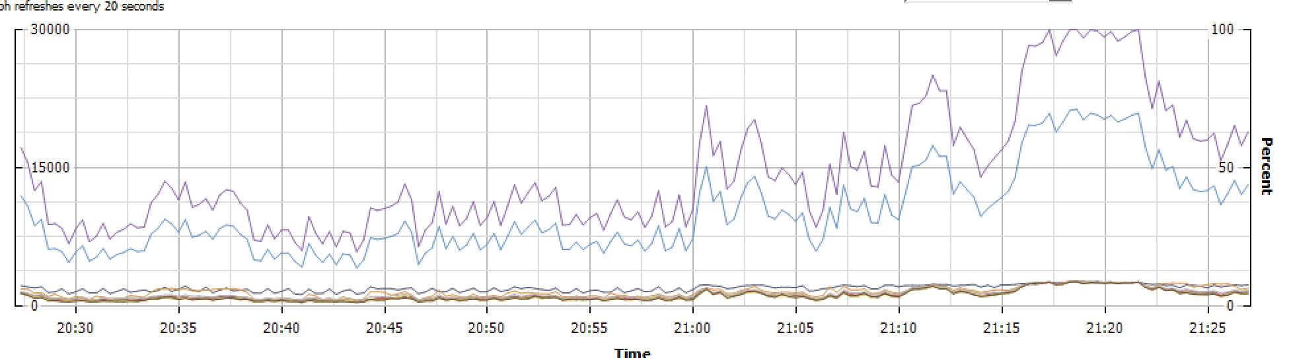
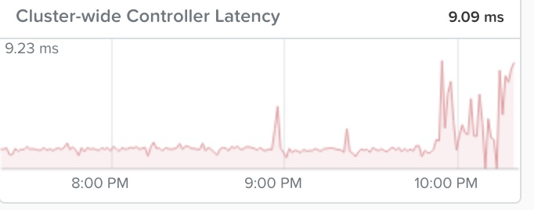
One Click Upgrade (almost)
Increased Load on other CVM
Small latency increase
Notes:
Upgrades of Acropolis ( CVM) are done regularly ( most of ours are done during the day)
Hypervisor also handled in same way
NCC done whenever new one is published
43% were running 4.6 100 days after release

Slide 24
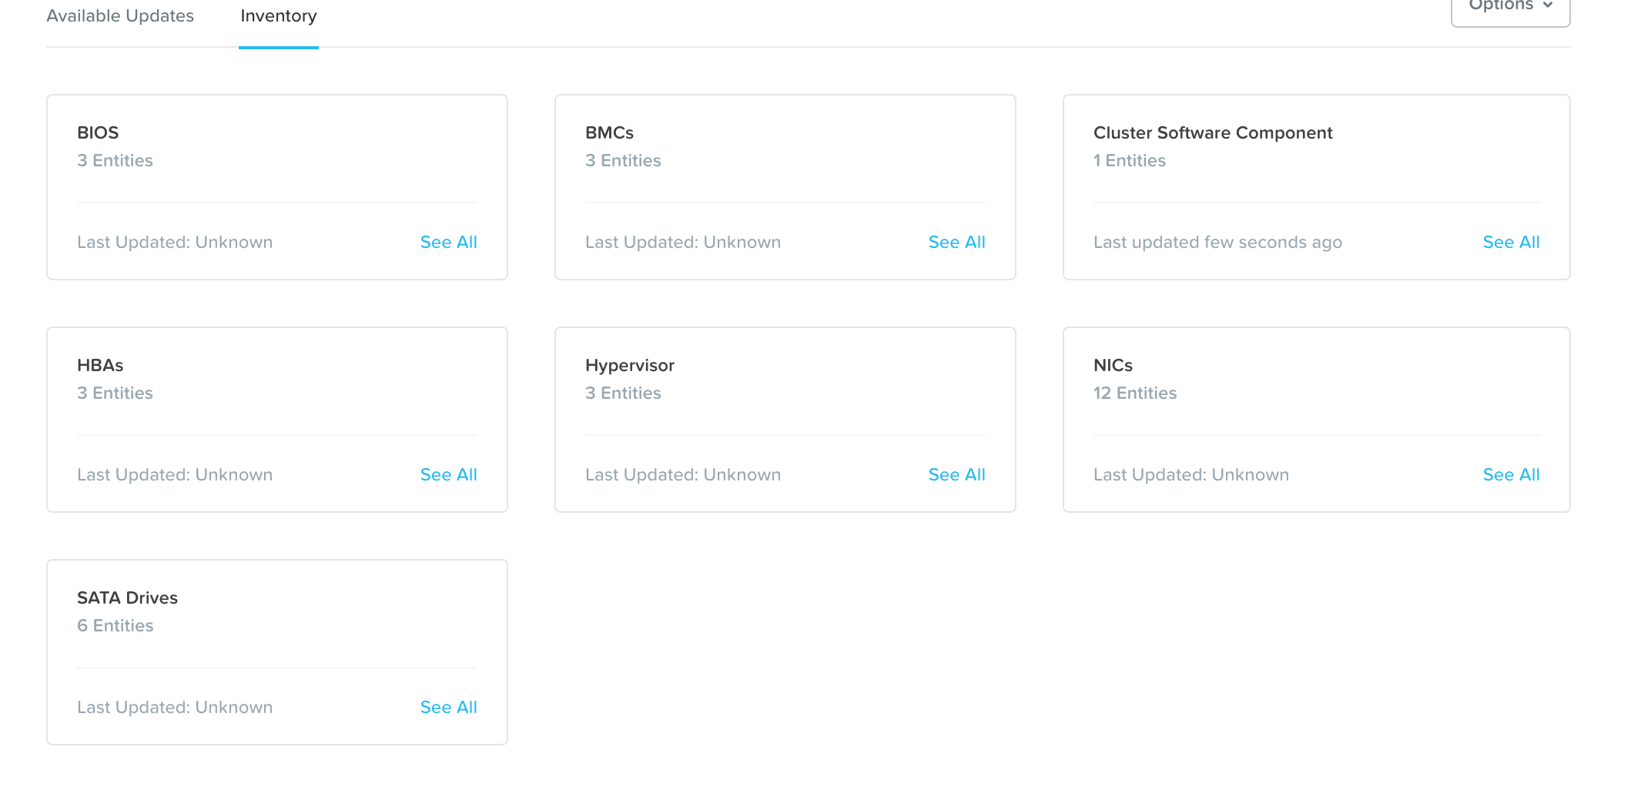
Lifecycle Management
Notes:
Everything designed to make your life easier
BIOS BMC HBA. Hypervisor NIC and Disk

Slide 25
Prism Central
Notes:
Shiny html5 snappy. Able to see hardware system and VM performance capacity Instantly

Slide 26
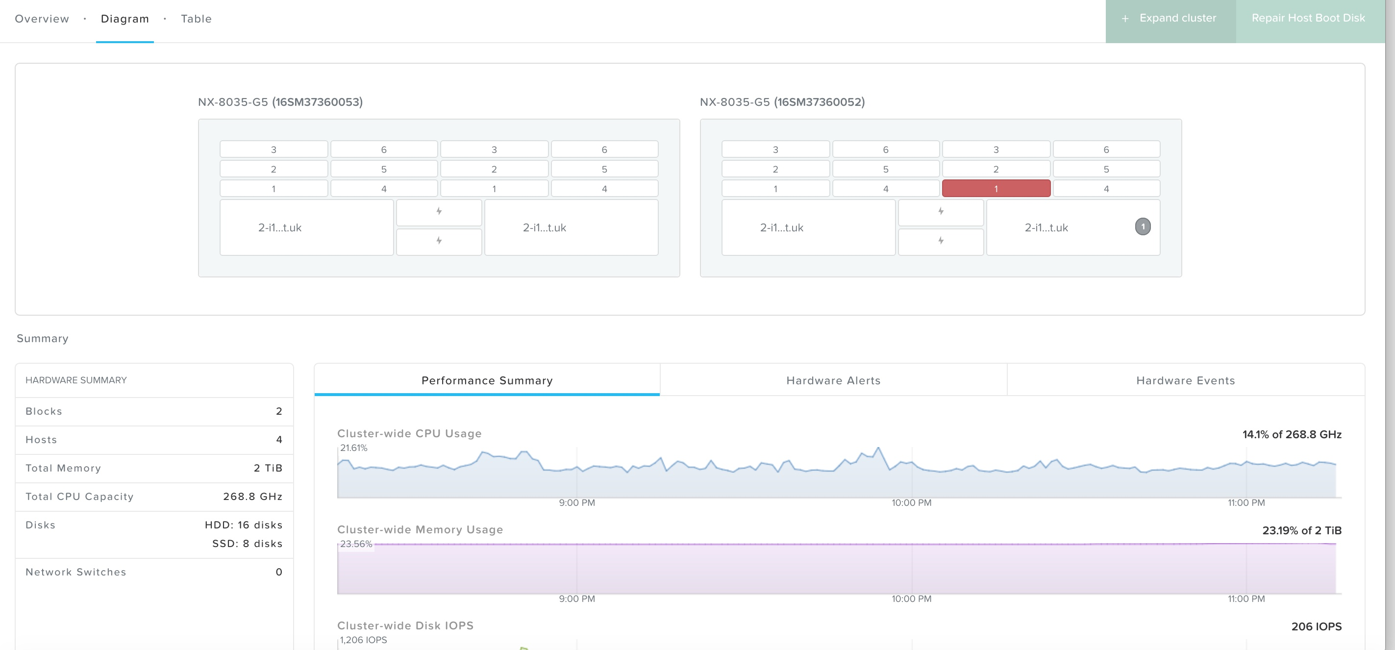
Failures
If delayed I/O detected by Stargate disk is offlined
Hades removes it from the data path and performs health checks
If unhealthy it tells Zeus to remove from cluster config
Red disk light turned on and alerts sent
Data rebalance performed
Notes:
Because all disks in the cluster are used return to RF happens quickly
Cold-Cold
Hot-Hot. so as not to blow cache
Performance consistent during rebuild

Slide 27
Failure Conditions..
DISK Failure - Non Issue. ( Loss of capacity)
SSD Failure - Reduction of cluster performance
CVM Failure - I/O distributed to other CVM’s
Node Failure- Loss of CPU RAM Storage + IOPS
Notes:
Built appropriately. N-1 means you loose all of the node
Can build RF3

Slide 28
The Really Good
Support - They have been exceptional
Expanding/Building clusters - 3 IP’s and your away
NCC - Built in enhanced health checks
Foundation - Provisioning tool
Backup - Performance in Veeam increased 5-10x
Density - 224 pCPU, 2TB of Ram 60TB usable storage 4U
Prism Search - vm iops <1500
Notes:
Overall very happy- Some caveats to watch out for
backup approx 1-1.2Tb per node per hour without impacting live
all vm’s more than 1500 iops or linux

Slide 29
Things to watch out for
Make sure you size the CVM correctly
SVMotion large VM’s to Nutanix is Slow….
Be careful with aggressive DRS settings
Extreme storage change rate in compressed timescale can cause problems
Time. Ensure NTP is setup correctly
Notes:
Easy to change CVM size but try and get it right first time
Never need to worry about Storage DRS ( unless changing container)
Change rate need to let Cassandra map reduce full scan
time Casandra ring distributed db. Rolling back time is v hard. forward ok

Slide 30
Whats Next ??
File Services
Containers
All Flash
Storage Only Nodes
Acropolis
Notes:
File services for scale out file services distributed per node. think vdi/citrix profile server etc

Slide 31
Nutanix CE - Try it out
1, 3 or 4 Node AHV Cluster
Notes:
5.5 release is now out

Slide 32
Feed4ward - It’s about the community
Step up - You might enjoy it.
Lots of support available
10-30 Min slots usually available
Notes:
Just because you think its trivial. Doesn't mean other people did
great talk about doing VMware on a budget
Not out to trip you up

Slide 33
Any Questions ?

Slide 34
Prizes + Beer

